Slide 1
HACKATHON PITCH
Every unit. Every bin.
One screen.
Inventory Management System: a secure, role-based web platform that replaces warehouse spreadsheets.
Ananthu C S · Easwari Engineering College, CSE · October 2026

Slide 2
Warehouses still run on guesswork
Registers and spreadsheets break down as stock grows
Wrong numbers
Lost time
No control
Manual entry and delayed updates mean recorded stock differs from what is on the shelf.
Finding a product, a bin or a damaged item means searching several files.
Shared sheets have no roles, no history and no single view of operations.
Result: stock-outs, mis-shipments and hours lost to manual reconciliation.
Inventory Management System · Hackathon Pitch
2

Slide 3
Our solution
One platform from receiving to dispatch
1
2
3
4
Know your stock
Move it safely
Fulfil orders
Predict and decide
Products, warehouses and bin locations linked in one live ledger.
Transfers and dispatches are blocked if stock is insufficient.
Orders flow Pending → Confirmed → Picking → Ready → Dispatched.
Smart insights show days of stock left, flag stock-out risk and suggest reorders.
Built with React · TypeScript · Node/Express · MongoDB
Inventory Management System · Hackathon Pitch
3

Slide 4
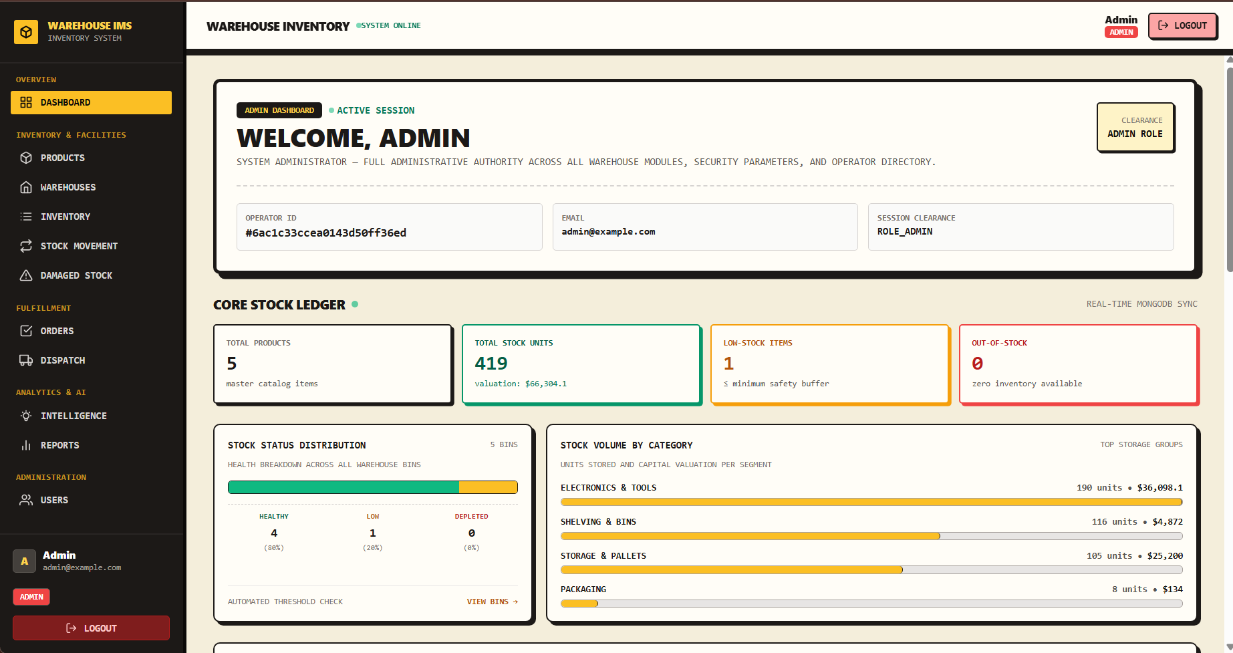
See it live
Dashboard: stock KPIs, status distribution and live activity at a glance
KPIs: products, units, valuation
Low-stock and out-of-stock counts
Stock status split and category chart
Live feed of recent stock activity
Smart alerts for Admin and Manager
Inventory Management System · Hackathon Pitch
4

Slide 5
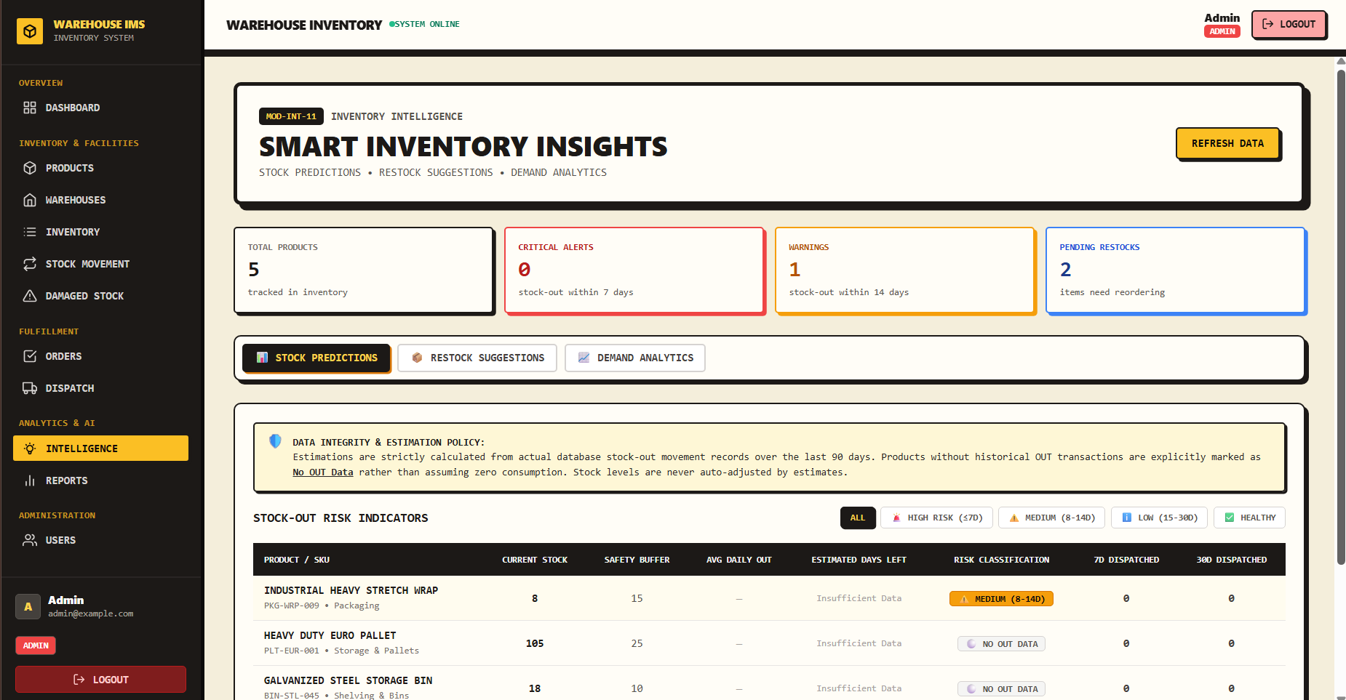
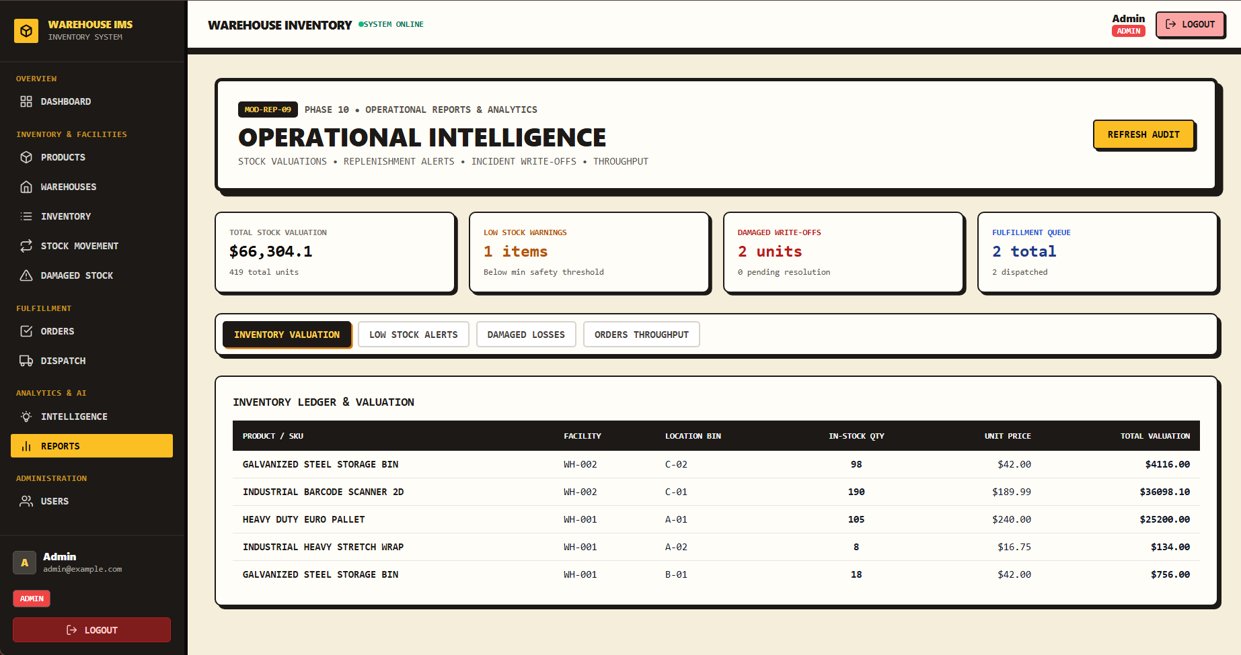
Smart insights, not just records
Decisions backed by real stock-out history
Inventory Intelligence
Operational reports
Days of stock left, five risk tiers and restock suggestions from 90 days of OUT history.
Valuation ledger, low-stock alerts, damaged losses and order throughput.
Inventory Management System · Hackathon Pitch
5

Slide 6
What makes it different
Rules live in the system, not in people's heads
Self-updating status
Safe stock moves
A save hook sets IN / LOW / OUT STOCK from quantity and threshold, so status never drifts.
Transfers and dispatches are rejected when the source bin cannot cover them.
Predictive insights
Role-based access
Estimates days to stock-out from 90 days of real OUT history; products with no data are flagged, never guessed.
JWT plus role middleware: each user sees and does only what their role allows.
Inventory Management System · Hackathon Pitch
6

Slide 7
Before and after
Same warehouse, one connected system
 | Spreadsheets / registers | Our system
Stock records | Manual, delayed | Centralised, always current
Finding items | Search separate files | Warehouse and bin linked to stock
Low stock | Spotted by manual checks | Automatic status and dashboard count
Movement history | Hand-written or missing | Logged IN / OUT / TRANSFER
Planning | Reorders by gut feeling | Days left, risk tier, suggested reorder qty
History | No record of who changed what | Before / after quantity and operator on every move
Access | Anyone with the file | Admin / Manager / Staff roles
Inventory Management System · Hackathon Pitch
7

Slide 8
Who it's for
Teams that outgrow spreadsheets but do not need a full ERP
Small warehouses
Retail and e-commerce
Distributors and SMEs
Single or multi-site stores that need bins and stock visibility.
Sellers managing stock, orders and dispatch together.
Teams with several staff roles who need controlled access.
Impact: fewer stock errors, faster order handling, and one source of truth for every role.
Effect sizes will be reported once measured in a pilot.
Inventory Management System · Hackathon Pitch
8

Slide 9
Roadmap
From working prototype to a deployable product
Now
Next
Later
Core platform: products, bins, inventory, movements, damaged stock, orders, dispatch, dashboard, Intelligence, CSV export, audit trail. 8/8 test suites and regression passed.
Barcode / QR scanning, automatic alerts, mobile-friendly UI, warehouse-specific forecasting.
Supplier and purchase orders, audit trail, demand forecasting, ERP and shipping integration.
Inventory Management System · Hackathon Pitch
9

Slide 10
Thank you
Inventory Management System
Ananthu C S (310624104022) · Guide: Ms. Nagamani Segalla
Easwari Engineering College, CSE
github.com/Ananthu2006-cse/FSD-Project

